Slide 1
Demonstration of TSD Data Extraction and Processing Tool
Webinar Series
Transportation Pooled Fund-5(385): Pavement Structural Evaluation with Traffic Speed Deflection Devices (TSDDs)
Senthil Thyagarajan
Transportation Engineer
Maintenance Division
TxDOT

Slide 2
Outline
Deflection file and fields of interest
Computed Indices
Required Inputs
Workbook Outline
Pre-analysis
Procedure
Layer Thickness
Backcalculation
Workbook customization for additional calculation

Slide 3
Information used from Deflection Output File
Deflection basin (from Greenwood Engineering or ARRB algorithm)
Dynamic and static load (used in normalization and backcalculation)
Surface Temperature (temperature correction of SCI and SN_{eff})
GPS co-ordinate (matching layer thickness, locating previous day average temperature, latitude used as a surrogate for binder stiffness in temperature correction)
Test day and time (used in Bells Equation for SCI temperature correction to compute mid depth temperature)

Slide 4
Deflection Indices – Quick Interpretation
AC Layer
Surface Curvature Index, SCI/SCI₁₂ = D₀-D₁₂ (or) SCI₈ = D₀-D₈
Base Layer
Base Curvature Index, BCI = D₁₂-D₂₄
Subgrade
SCI_Subgrade = D₃₆-D₆₀
D₆₀ or deflection farther can be used to compute subgrade modulus (AASHTO 1993)
Deflection Slope Index, DSI = D₁₂-D₃₆

Slide 5
Temperature Corrected, SCI₁₂
$$λ=\frac{SCI_{Ref}}{SCITSD}=\frac{{10}^{−0.05014T_{Ref}+0.019049T_{Ref}log\left(h_{AC}\right)log\left(φ\right)}}{{10}^{−0.05014T+0.019049Tlog\left(h_{AC}\right)log\left(φ\right)}}$$
where
λ = Temperature adjustment factor
SCI_{TSD} = SCI computed from TSD and normalized to standard load
SCI_{Ref} = Adjusted SCI_{TSD} at reference temperature
T_{Ref} = Reference temperature, °C
T= Mid-depth AC layer temperature at time of measurement, °C
(computed using Bells equation code available in
https://www.fhwa.dot.gov/publications/research/infrastructure/pavements/ltpp/98085/tempred.cfm)
h_{AC}= Asphalt Concrete layer thickness, mm
Φ = Latitude of measurement location (within 30 to 50 degrees) as a surrogate for asphalt stiffness
Required Additional Inputs:
Previous day average temperature to find mid-depth temperature using Bells Equation and surface temperature (https://gis.ncdc.noaa.gov/maps/ncei/summaries/daily)
AC layer thickness
From Nasimifar, M., Chaudhari, S., Thyagarajan, S., & Sivaneswaran, N. (2018) Temperature adjustment of Surface Curvature Index from Traffic Speed Deflectometer measurements, International Journal of Pavement Engineering, DOI: 10.1080/10298436.2018.1546858

Slide 6
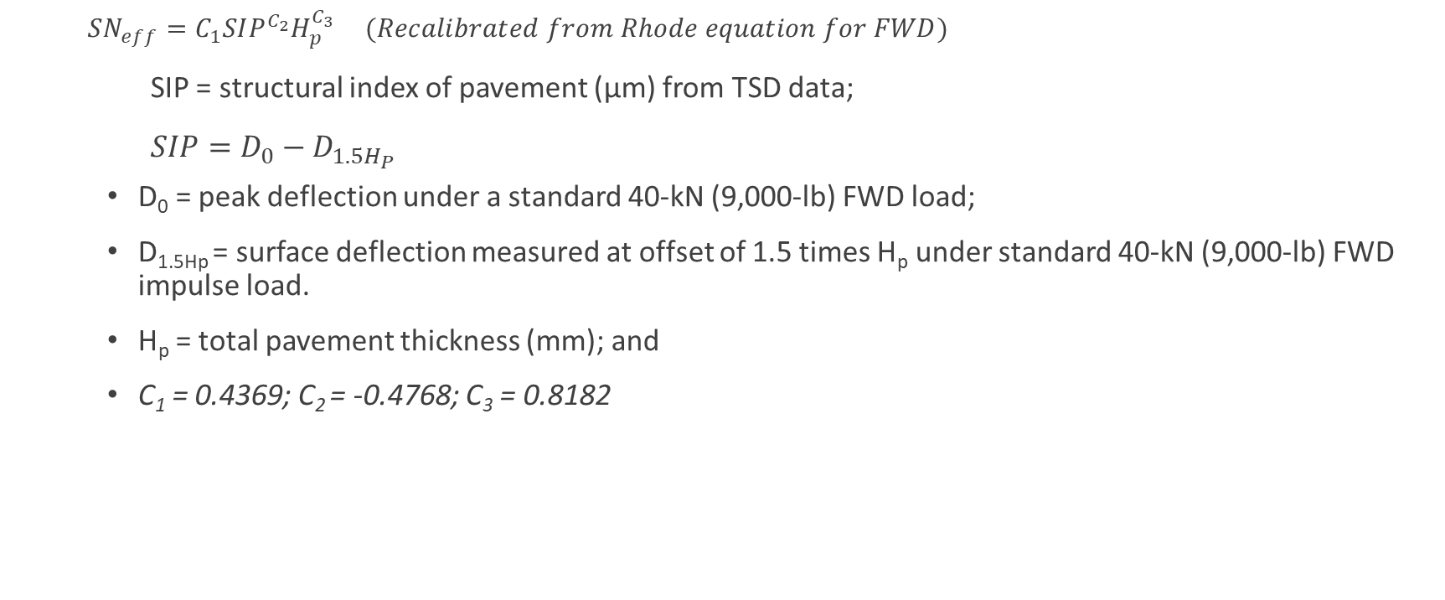
Effective Structural Number (Rhode Equation)
$SN_{eff}=C_{1}SIP^{C_{2}}H_{p}^{C_{3}} (Recalibrated from Rhode equation for FWD)$
SIP = structural index of pavement (μm) from TSD data;
$SIP=D_{0}−D_{1.5H_{P} }$
D₀ = peak deflection under a standard 40-kN (9,000-lb) FWD load;
D_{1.5Hp} = surface deflection measured at offset of 1.5 times H_{p} under standard 40-kN (9,000-lb) FWD impulse load.
H_{p} = total pavement thickness (mm); and
C₁ = 0.4369; C₂ = -0.4768; C₃ = 0.8182
Required Additional Inputs:
Total pavement thickness, H_{P} above subgrade
Temperature correction for D₀ to 68F
from Nasimifar, M., Thyagarajan, S., Chaudhari, S., & Sivaneswaran, N. (2019). Pavement Structural Capacity from Traffic Speed Deflectometer for Network Level Pavement Management System Application. Transportation Research Record, 2673(2), 456–465. https://doi.org/10.1177/0361198118825122

Slide 7
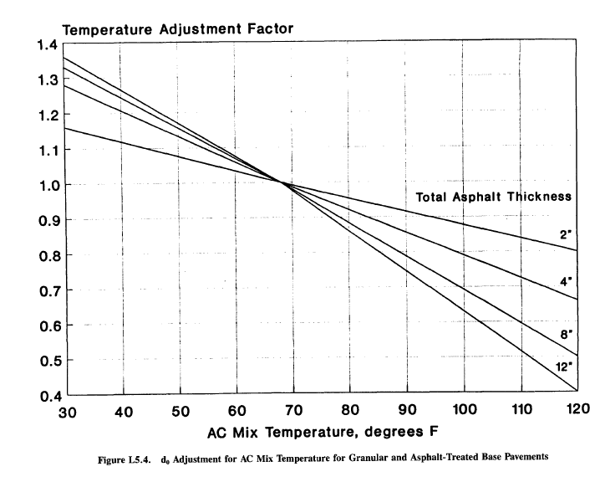
Temperature Adjustment Factor for D₀
From AASHTO 1993,
Reference temperature 68ºF
Curves converted to equation

Slide 8
TxDOT Structural Condition Index
$$structural condition index, SCI= \frac{SN_{Eff}}{SN_{Req}}$$
SN_{eff} from recalibrated Rhode’s equation
SN_{Req} based on
estimated 20-year Equivalent Single Axle Loads (ESALs) for the route, and
subgrade modulus (M_{R})
Subgrade Modulus computed from D₇₂ using AASHTO 1993
Required Additional Inputs:
Estimation of
20-year ESALs
Mr
SNreq

Slide 9
Workbook Outline
‘Input’ – main worksheet that contain the command button to extract and analyze data. Also contains input default values.
Make changes as required.
‘OutputFormat’ – contains outline of the calculations. The code will copy the content of this worksheet to the imported deflection worksheet.
Changes are required only if additional indices/parameters are appended
‘Defl_File_Format’ – Contains the location reference for the required data in the TSD deflection file.
Update the column location if the TSD deflection file format changes.
‘LEA’ – contains backcalculation worksheet.
Changes are not required.

Slide 10
Pre-analysis Check
Before extracting data,
Verify the deflection worksheet is the first worksheet.
Verify the data format and make any required changes to the “Defl_File_Format” worksheet.
Verify if the column numbers next to each column in ‘Defl_file_format’ worksheet match the column location for the key variables in the deflection file.
Extract previous day average temperature for the test route from https://gis.ncdc.noaa.gov/maps/ncei/summaries/daily.
The DLL file ‘EVERSERS.dll’ required for backcalculation should be placed in c:\Temp\EVERSERS.dll

Slide 11
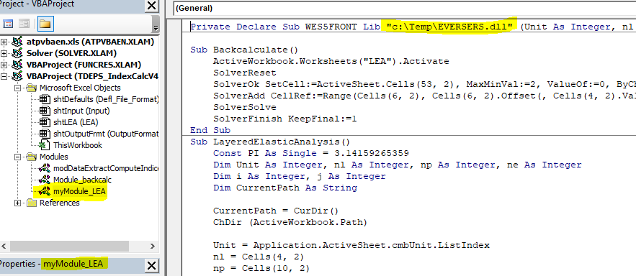
Backcalculation – Locating Eversers.dll file
Default Location
Custom Location

Slide 12
Input Worksheet
GPR reported spacing: If the deflection chainage and closest layer thickness chainage are farther than this GPR reported spacing, the current/default thickness value will be retained.

Slide 13
Extracting previous day average temperature
Used in SCI temperature correction (Nasimifar et al. 2018)
Go to the website https://gis.ncdc.noaa.gov/maps/ncei/summaries/daily
Enter GPS coordinate, previous day (date) of testing and press update map
Obtain the previous day average temperature from the station closer to the testing route

Slide 14
Defl_File_Format Worksheet
Sample TSD Deflection Worksheet

Slide 15
Flexibilities
Expanding default index calculations: User can expand default indices in “outputFormat” worksheet with extra columns to do additional calculations.
This serves as a default format on subsequent data extraction

Slide 16
Procedure
Verify and update the input values in the ‘input’ worksheets.
Use ‘Select and Import Deflection Data’ command button to Select the deflection file.
The code will copy all the worksheets from the selected file to this workbook.
The first worksheet will the renamed “TSD_Data” and second worksheet will be renamed “Data_Dictionary".
All calculations will be done only in the “TSD_Data” worksheet. The tool computes the indices with default values entered the “input” worksheet when required.
The tool post the relevant computation formula in the worksheet. Thus the user has the option (if preferred) of changing the layer thicknesses and previous day average temperature for each/subgroup of record after data extraction and index computation.

Slide 17
Layer Thickness
The tool uses the default layer thickness (entered in “input” worksheet).
Use ‘select and import GPR’ to import layer thickness from separate workbook
thickness data can be either at the interval of the reported deflections or in flexible intervals
code will find matching chainage or GPS co-ordinates within distance provided in ‘GPR reported spacing’
Layer thickness can also be entered manually

Slide 18
Backcalculation
WesLEA layered elastic solution
Optimization uses Excel’s Generalized Reduced Gradient (GRG) non-linear method

Slide 19
Backcalculation
Last two layers are assumed as
both subgrade or
subgrade and stiff layer.
If subbase thickness is provided, the tool combines subbases in to one layer

Slide 20
Thanks Questions
Senthilmurugan.Thyagarajan@txdot.gov

Slide 21
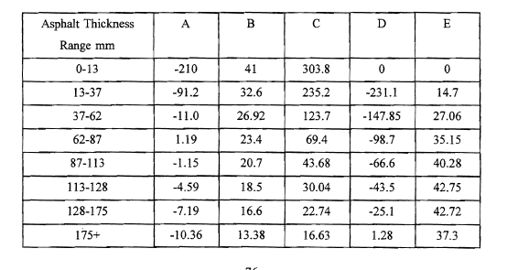
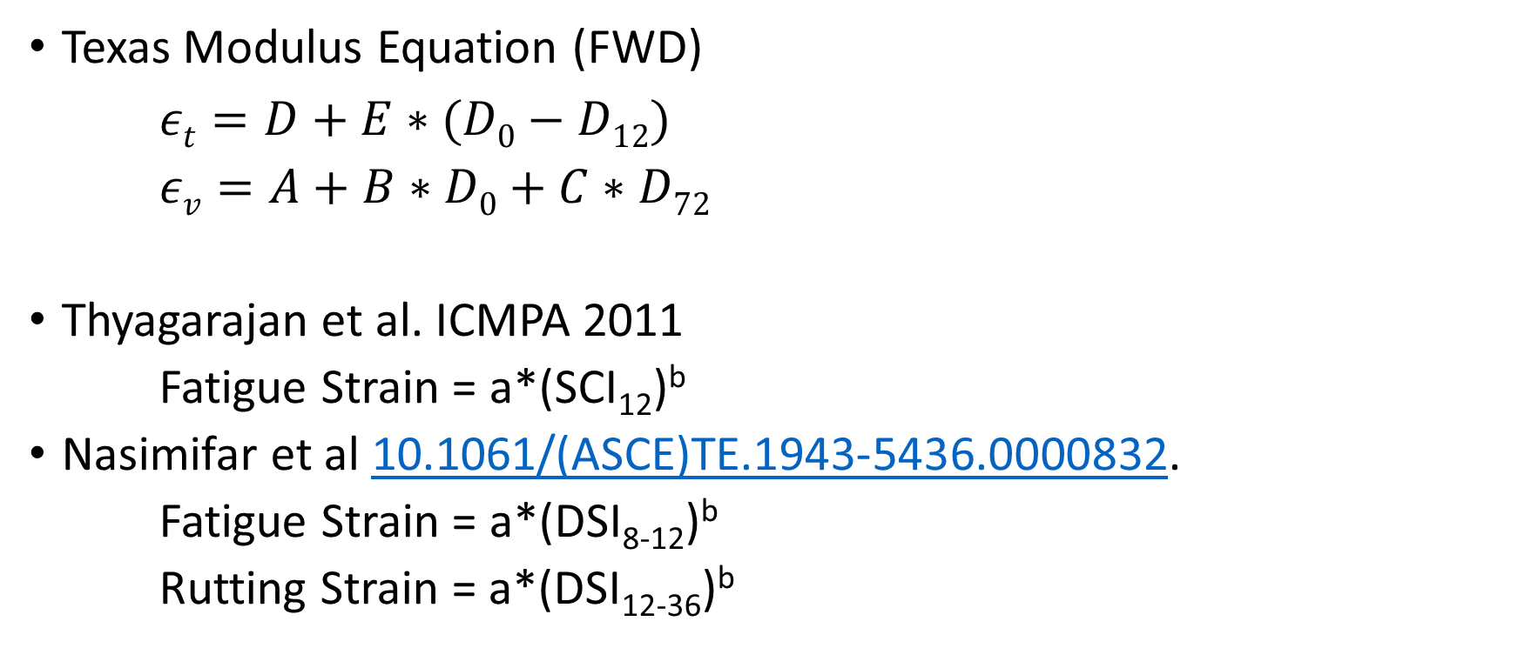
Critical Strain
Texas Modulus Equation (FWD)
$εt=D+E∗(D0−D12)$
$εv=A+B∗D0+C∗D72$
Thyagarajan et al. ICMPA 2011
Fatigue Strain = a*(SCI₁₂)^{b}
Nasimifar et al 10.1061/(ASCE)TE.1943-5436.0000832.
Fatigue Strain = a*(DSI₈₋₁₂)^{b}
Rutting Strain = a*(DSI₁₂₋₃₆)^{b}

Slide 22
Remaining Life Estimates
Asphalt Institute equation
Texas Transportation Institute
N_{R} is number of 18 kip ESAL's to induce a 12 mm rut,
N_{C} is number of 18 kip ESAL' s to induce cracking in 30% of the wheel paths,
SM is stiffness of asphalt in month of analysis, computed from monthly asphalt temperatures, and
ACP is thickness of asphalt layer in inches.
$$NR=\frac{1.94 x 105}{(εv/1000)4}$$
$$Nc=10∗∗\left[A0−3.291\log\left(εt\right)−0.854\log\left(\frac{SM}{1000}\right)\right]$$
A₀ = 16.086 + ACP/15
Incorporating a Structural Strength Index into the Texas Pavement Evaluation (Scullion, April 1988). TTI

Slide 23
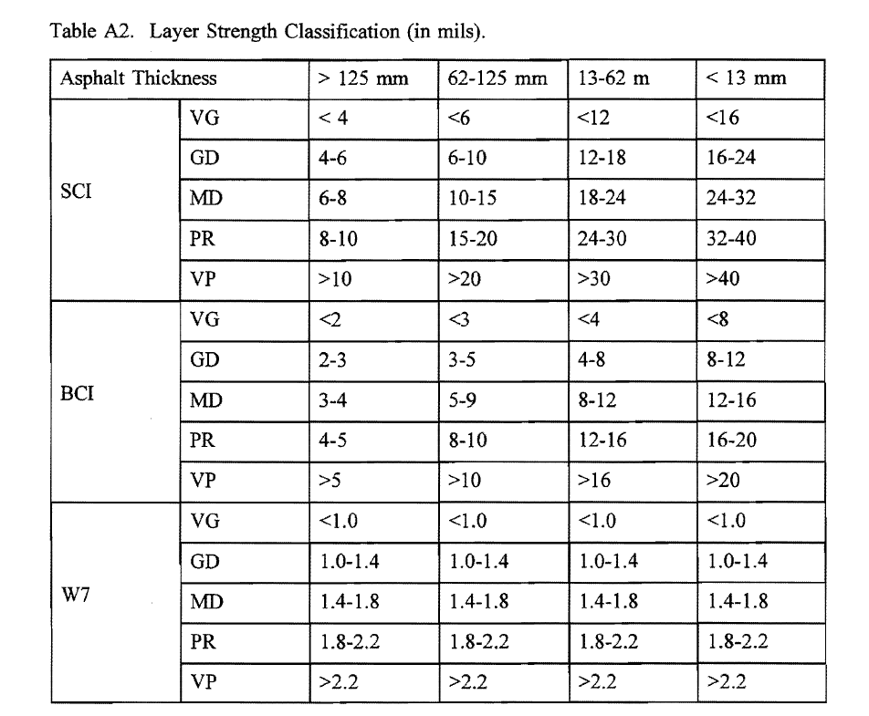
FWD based Index Thresholds

