Slide 1
The Next Pooled Fund
Strategic Implementation Through Cooperative Pavement Research
Glenn Engstrom, MnDOT
Director, Office of Materials and Road Research

Slide 2
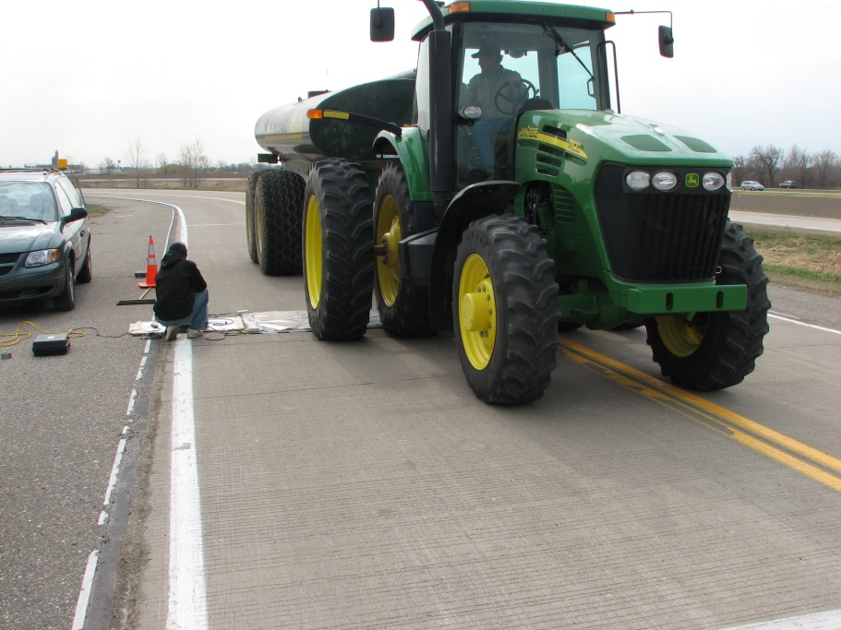
Primary Emphasis Areas
Local and State Sponsored Research
Implementation Focus
Technology Transfer
Training

Slide 3
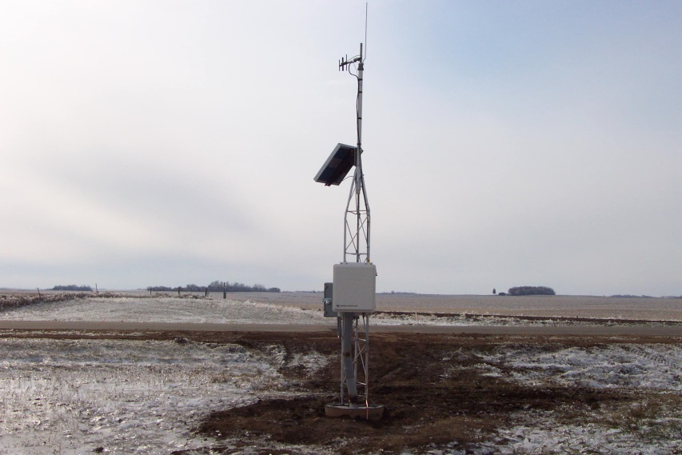
Structure
Governing Board
Sets goals and mission
Executive Committee
Sets research objectives, goals and project selection
Associates
Provide innovative solutions to the State and Local identified research problem statements
Academia
Provide input on new technology and complete research projects

Slide 4
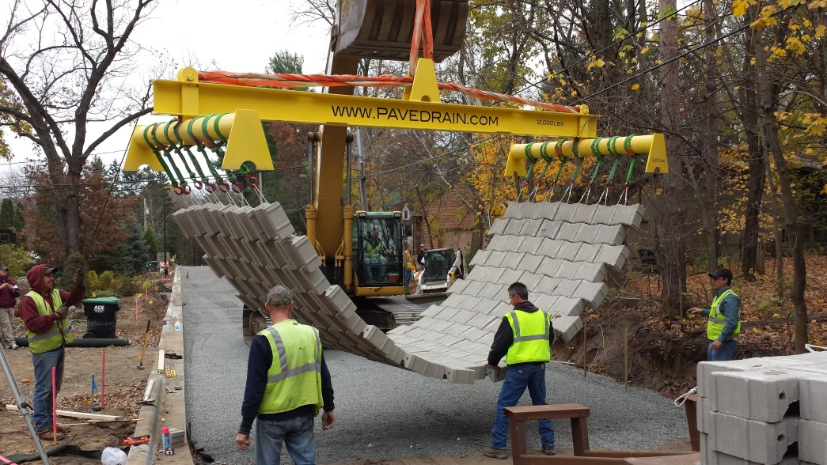
Governing Board
Board Meetings
Three LRRB and three MnDOT members
Set overall direction
Establish goals
Expand strategic partnerships

Slide 5
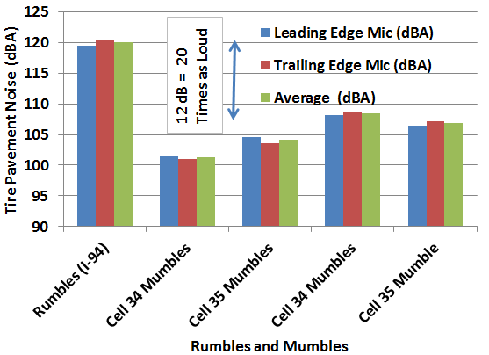
Executive Committee
Executive Committee Meetings
Major sponsors and Governing Board
Set research objectives and scope
Select projects for Phase 3 at MnROAD
Select project teams
Include training, tech transfer and implementation as a part of each project

Slide 6
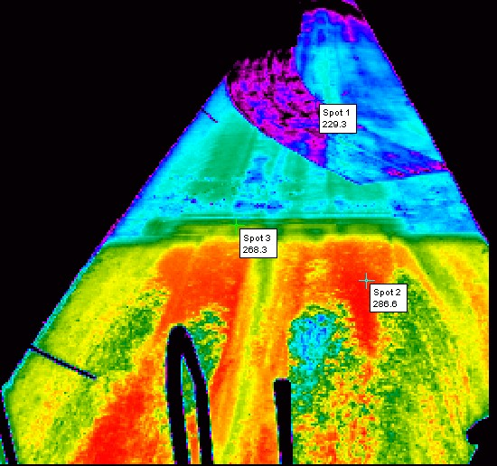
Project Teams
Research Project Teams
Chaired by Executive Member
Associate and Academic membership
Make decisions on $2.5 million construction funding at MnROAD
Design the experiment through implementation
Tech Transfer Team
Chaired by Executive Member
Associate and Academic membership
Newsletters
Webinars
Training
Implementation Series
Select shovel ready technologies
Pavement Conference/NCAT Conference
All members meeting prior to conferences

Slide 7
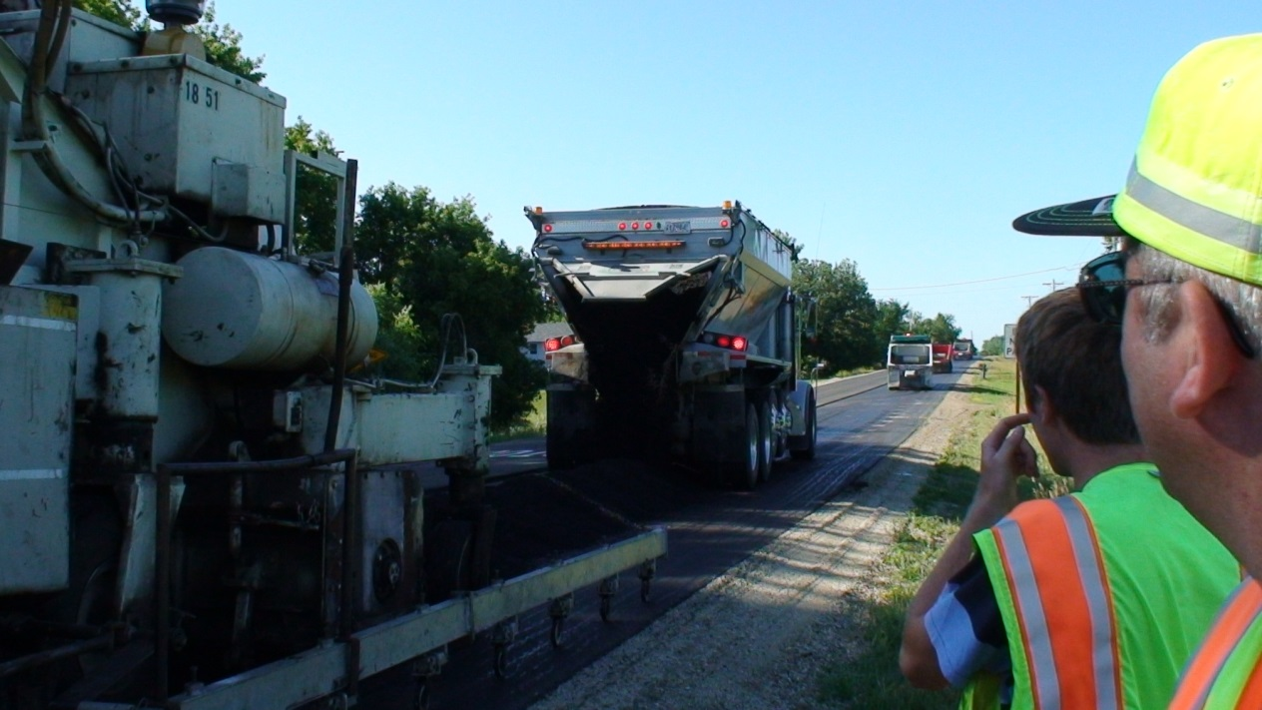
Project Teams
Communications Team
Chaired by Executive Member
Associate and Academic membership
Newsletters
Web site
Outreach

Slide 8
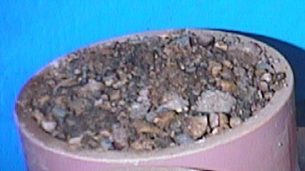
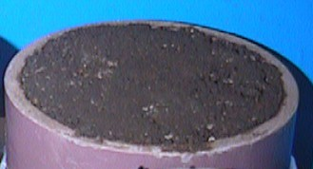
Thank You

