Slide 1
Conventional Whitetopping (COA)
Presenter: Julie Vandenbossche (Pitt) Project Info:
Team: Kelly Smith (APTech) Chris Brakke (IDOT)
Linda Pierce (NCE) Ben Behnami (IDOT) Jennifer Albert (FHWA)
Tom Yu (FHWA)

Slide 2
PaveME Asphalt Overlay Design Options
Existing AC Pavement
Flexible
Semi-rigid
Existing Fractured PCC Pavement
Crack and seat
Break and seat
Existing Intact PCC Pavement
JPCP and CRCP
Composite pavements
Rubblization
Previously AC overlaid pavements
Others
Seal coat over existing AC pavement
Overlay with interlayer

Slide 3
PCC Overlay Types & Corresponding PMED Design
Conventional Whitetopping (COA) –Overlay a distressed asphalt with a JPCP.
Design:
Overlay: JPCP over AC

Slide 4
Application- Distressed asphalt pavement
Conventional Whitetopping (UCOA)
Bonded Whitetopping (BCOA)

Slide 5
Application- Distressed asphalt pavement
Conventional Whitetopping (UCOA)
How should the overlay be designed?
Bonded Whitetopping (BCOA)
?

Slide 6
Application- Distressed asphalt pavement
Overlay Thickness

Slide 7
Application- Distressed asphalt pavement
Overlay Thickness
> 6 in
< 6 in

Slide 8
Application- Distressed asphalt pavement
Overlay Thickness
> 6 in
< 6 in
Bonded Whitetopping (BCOA)
All slabs
C
A
B
O
ME
University of Pittsburgh

Slide 9
Application- Distressed asphalt pavement
Overlay Thickness
> 6 in
< 6 in
Bonded Whitetopping (BCOA)
All slabs
Short slabs
C
A
B
O
ME
University of Pittsburgh
CoDOT Design Procedure

Slide 10
Application- Distressed asphalt pavement
Overlay Thickness
> 6 in
< 6 in
Bonded Whitetopping (BCOA)
Very short slabs
(Only considers corner breaks)
All slabs
Short slabs
C
A
B
O
ME
University of Pittsburgh
CoDOT Design Procedure

Slide 11
Application- Distressed asphalt pavement
Overlay Thickness
> 6 in
< 6 in
Conventional Whitetopping (UCOA)

Slide 12
Application- Distressed asphalt pavement
Overlay Thickness
> 6 in
< 6 in
Conventional Whitetopping (UCOA)
New Pavement with AC base

Slide 13
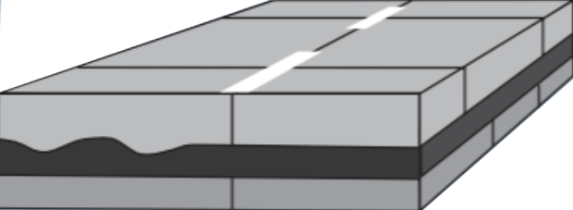
Application- Distressed composite pavement

Slide 14
Application- Distressed composite pavement
HMA Thickness
> 3 in
< 3 in

Slide 15
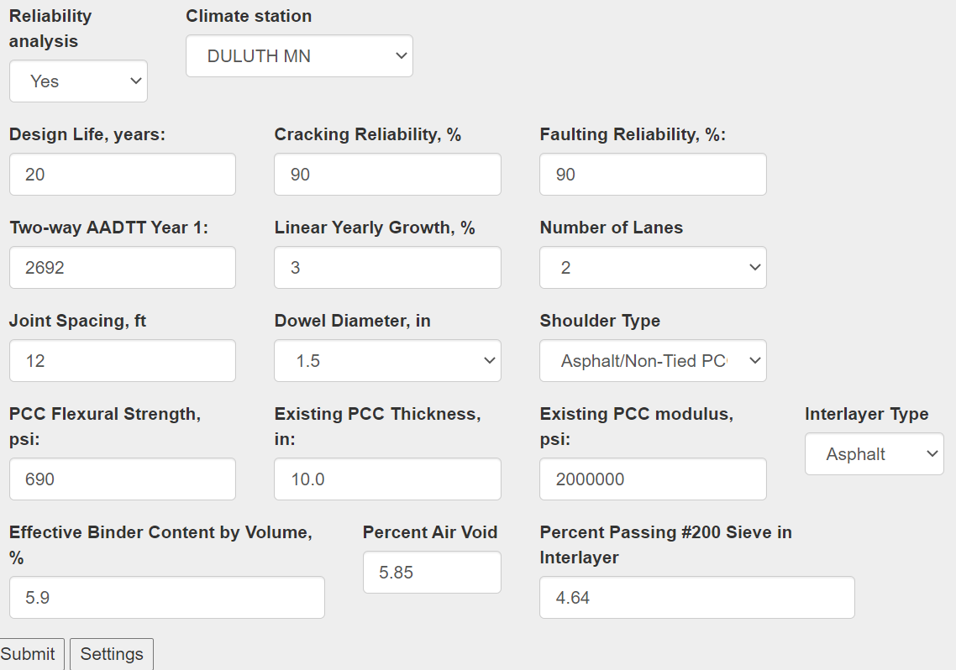
Application- Distressed composite pavement
HMA Thickness
> 3 in
< 3 in
PITT UBOL-ME
Unbonded Overlay (UBOL)

Slide 16
Application- Distressed composite pavement
HMA Thickness
> 3 in
< 3 in
Whitetopping
(COA)

Slide 17
Application- Distressed composite pavement
HMA Thickness
> 3 in
< 3 in
Whitetopping
(COA)
Overlay Thickness
< 6 in
> 6 in

Slide 18
Application- Distressed composite pavement
HMA Thickness
> 3 in
< 3 in
Whitetopping
(COA)
C
A
B
O
ME
Overlay Thickness
< 6 in
> 6 in
University of Pittsburgh
CoDOT Design Procedure
Bonded Whitetopping (BCOA)

Slide 19
Application- Distressed composite pavement
HMA Thickness
> 3 in
< 3 in
Whitetopping
(COA)
Overlay Thickness
< 6 in
> 6 in
Conventional Whitetopping (UCOA)

Slide 20
Poll Question #3

Slide 21
Poll Question #4

Slide 22
Conventional Whitetopping (COA)

Slide 23
PaveME – Conventional Whitetopping (COA)
 | New Design JPCP on AC Base | Overlay JPCP over AC | SJPCP
Slab thickness | > 6 in | > 6 in | 4 - 8 in
Slab length | 12-20 ft | 12-20 ft | 5 - 8 ft
AC Stiffness | New AC | Reduced based on % Fatigue cracking | Constant 65% fatigue cracking
Structural model | Slab= PCC + AC | Slab= PCC + AC | Slab= PCC + AC
Calibration data | New pavements | New pavements | BCOA

Slide 24
PaveME – Conventional Whitetopping (COA)
JPCP Layer Properties:
Select erodibility index based on the layer that will be pumped.
PCC
AC
Base
Subgrade

Slide 25
PaveME – Conventional Whitetopping (COA)
JPCP Layer Properties:
Full friction recommended for life of the pavement (MOP).

Slide 26
PaveME – Conventional Whitetopping (COA)
AC Layer Properties: Level 2
Milled thickness
Percent fatigue cracking

Slide 27
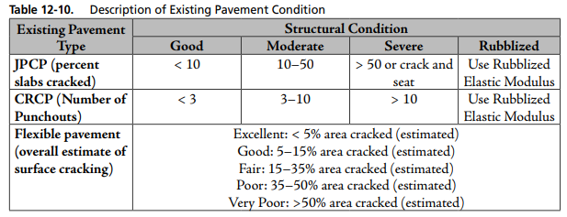
PaveME – Conventional Whitetopping (COA)
AC Layer Properties: Level 3
Milled thickness
Percent fatigue cracking

Slide 28
PaveME – Conventional Whitetopping (COA)
Pavement structure:
Must have 2 layers below the AC layer
PCC
AC
Base
Subgrade

Slide 29
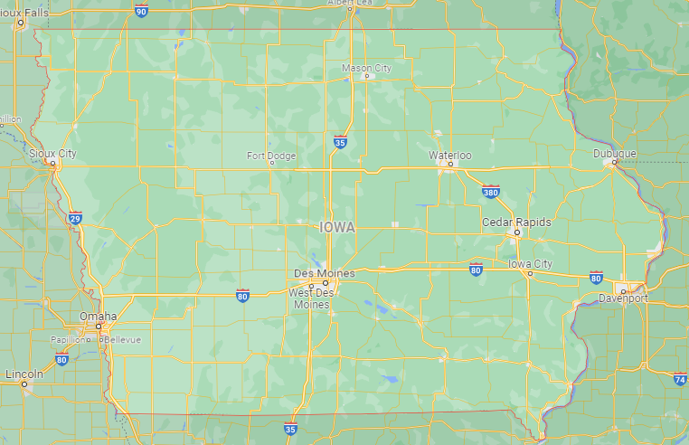
Example project: US 71 Iowa (Clay/Dickinson Cnty)
Project Location
US71

Slide 30
Example project: US 71 Iowa (Clay/Dickinson Cnty)
24-ft wide HMA Pavement
11 in HMA (3 in surface and 8 in base mix)
P200 = 4.3
Effective Binder = 7.5%
Air voids = 7%
Subgrade
P200 = 50%
k-value = 100 psi/in
Distress
0-8% Fatigue cracking
Transverse cracking

Slide 31
Example project: US 71 Iowa (Clay/Dickinson Cnty)
Traffic:
Roadway Classification = Major arterial
Two-way ADT = 4,800
Percent trucks = 10 percent
Design life = 20 years
Growth = 2 percent compound

Slide 32
Example project: US 71 Iowa (Clay/Dickinson Cnty)
Overlay
MOR = 600 psi
E = 6000 ksi/in
Thermal coef = 3.8 x 10⁻⁶ /F
Cement content = 550 lbs/cyd
12-ft joints, No Dowels

Slide 33
Example project: US 71 Iowa (Clay/Dickinson Cnty)

Slide 34
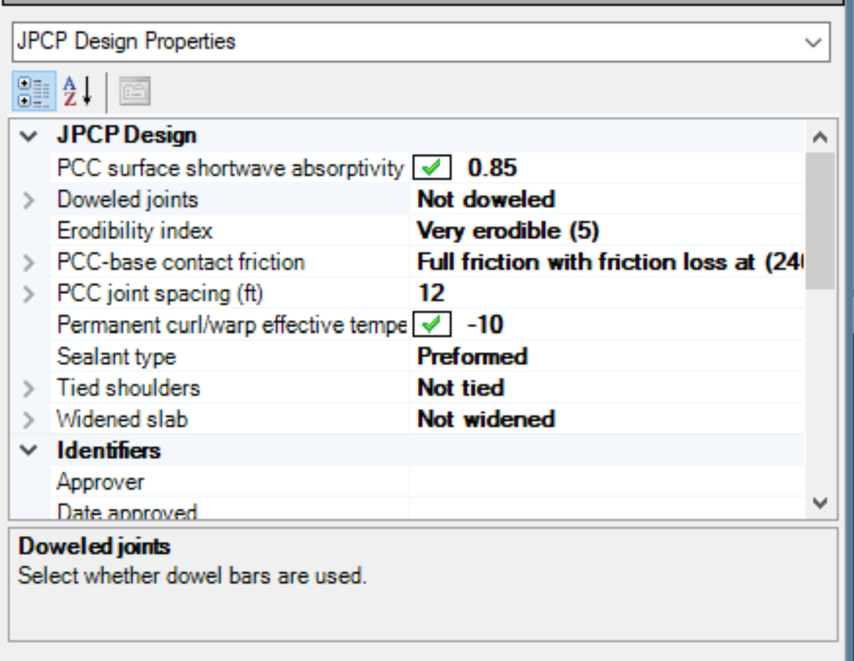
Example project: US 71 Iowa (Clay/Dickinson Cnty)
JPCP Layer Properties:
Select erodibility index based on the layer that will be pumped – poor subgrade (5)
PCC
AC
Base
Subgrade

Slide 35
Example project: US 71 Iowa (Clay/Dickinson Cnty)
JPCP Layer Properties:
Full friction recommended for life of the pavement (MOP) – 240 mths

Slide 36
Example project: US 71 Iowa (Clay/Dickinson Cnty)
AC Layer Properties: Level 3

Slide 37
Example project: US 71 Iowa (Clay/Dickson Cnty)
AC Layer Properties: Level 3

Slide 38
Example project: US 71 Iowa (Clay/Dickinson Cnty)
Subgrade: k- 100 psi/in
Granular layer required between HMA and subgrade
Layer 3: Non-stabilized base; A-3; MR = 10,000 psi (min)
Layer 4: Subgrade; A-7-5; MR = 7,000 psi

Slide 39
Example project: US 71 Iowa (Clay/Dickinson Cnty)
Subgrade: k- 100 psi/in
Granular layer required between HMA and subgrade
Layer 3: Non-stabilized base; A-3; MR = 10,000 psi (min)
Layer 4: Subgrade; A-7-5; MR = 7,000 psi

Slide 40
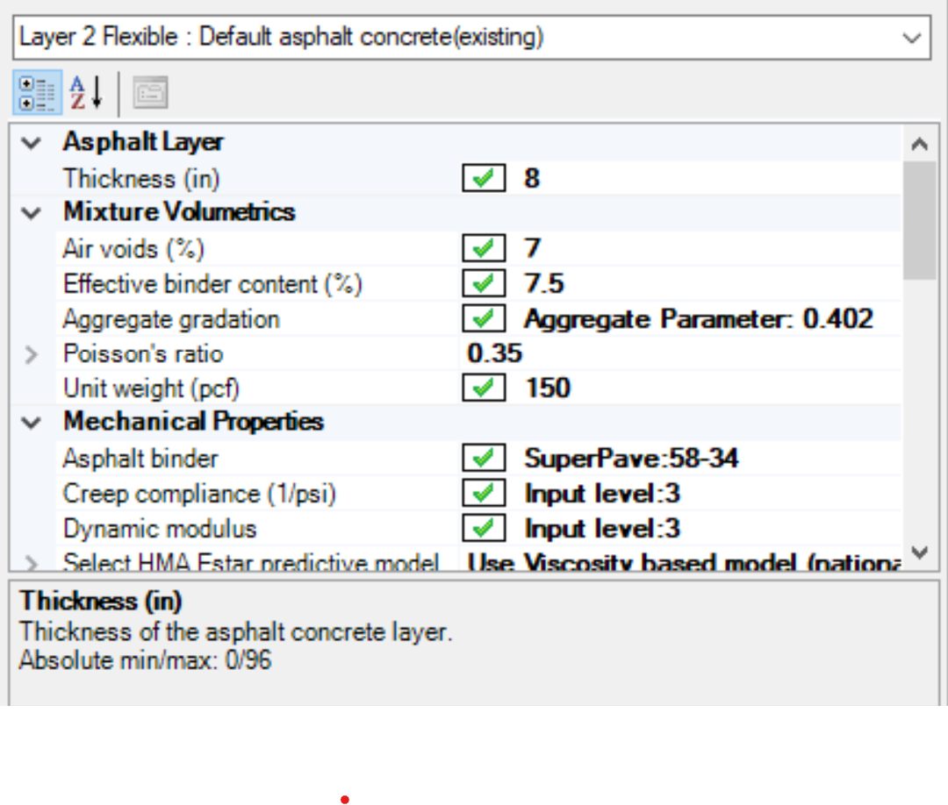
Example project: US 71 Iowa (Clay/Dickinson Cnty)
Layer 2 Flexible: 8 in HMA
(11 – 3 milled = 8 in)

Slide 41
Example project: US 71 Iowa (Clay/Dickinson Cnty)
ESALS = 3.1 Million
Overlay: JPCP over AC
(12-ft joints; undoweled)
< 5 in

Slide 42
Example project: US 71 Iowa (Clay/Dickinson Cnty)
ESALS = 3.1 Million
Unbonded COA
(new pavement on AC base)
Overlay: JPCP over AC
(12-ft joints; undoweled)
< 5 in

Slide 43
Example project: US 71 Iowa (Clay/Dickinson Cnty)
ESALS = 3.1 Million
Unbonded COA
(new pavement on AC base)
6 in
Overlay: JPCP over AC
(12-ft joints; undoweled)
< 5 in
Notes:
Unbonded COA
(new pavement on AC base

Slide 44
Example project: US 71 Iowa (Clay/Dickinson Cnty)
ESALS = 3.1 Million
C
A
4-5 in
6 in used
B
O
Bonded COA
(6 ft x 6 ft joints)
ME
University of Pittsburgh
Unbonded COA
(new pavement on AC base)
6 in
Overlay: JPCP over AC
(12-ft joints; undoweled)
< 5 in

Slide 45
Example project: US 71 Iowa (Clay/Dickinson Cnty)
ESALS = 31 Million
Overlay: JPCP over AC
(12-ft joints; undoweled)
= 6 in

Slide 46
Example project: US 71 Iowa (Clay/Dickinson Cnty)
AC Layer Properties: Level 3

Slide 47
Example project: US 71 Iowa (Clay/Dickinson Cnty)
ESALS = 31 Million
Overlay: JPCP over AC
(12-ft joints; undoweled)
= 6 in

Slide 48
Example project: US 71 Iowa (Clay/Dickinson Cnty)
AC Layer Properties: Level 3

Slide 49
Example project: US 71 Iowa (Clay/Dickinson Cnty)
ESALS = 31 Million
Overlay: JPCP over AC
(12-ft joints; undoweled)
= 6 in

Slide 50
Example project: US 71 Iowa (Clay/Dickinson Cnty)
AC Layer Properties: Level 3

Slide 51
Example project: US 71 Iowa (Clay/Dickinson Cnty)
ESALS = 31 Million
Overlay: JPCP over AC
(12-ft joints; undoweled)
= 6 in

Slide 52
Example project: US 71 Iowa (Clay/Dickinson Cnty)
New Design: JPCP over AC base
(12-ft joints; undoweled)
= 6 in

Slide 53
Example project: US 71 Iowa (Clay/Dickinson Cnty)
New Design: JPCP over AC base
(12-ft joints; undoweled)
= 6 in

Slide 54
Example project: US 71 Iowa (Clay/Dickinson Cnty)
ESALS = 31 Million
Overlay: JPCP over AC
(12-ft joints; undoweled)
New Design: JPCP with AC base
(12-ft joints; undoweled)
vs

Slide 55
QUESTIONS?

