Slide 1
Flood-Frequency Analysis in the Midwest: Addressing Potential Nonstationary Annual Peak-Flow Records
Transportation Pooled Fund TPF-5(460)
https://www.pooledfund.org/Details/Study/687

Slide 2
Scope of Work

Slide 3
Scope of Work
Publicly released annual peak streamflow used in study (possibly other metrics of high flow) and watershed-based climate data (metrics of precipitation and temperature). These data will also contain trend results;
Characterize the effects of natural hydroclimatic shifts and potential climate change on annual peak flows in Midwest;
Analyze the seasonality of flood peaks in the region and their trends and implications for trend attribution;
Evaluate the effect of urbanization on flood-peaks in major metropolitan areas in the study region;
Publicly released data that compares flood-frequency adjustment methods at individual sites;
Summarize methods for addressing regional hydroclimatic shifts, climate change, and land-use change in peak-flow frequency analyses in the Midwest; and
Succinctly summarize the above work in a short fact sheet or story map that provides links to project products to make it easy to find data and results.

Slide 4
Scope of Work–Hydroclimatic Variability
(1) Publicly released annual peak streamflow used in study (possibly other metrics of high flow) and watershed-based climate data (metrics of precipitation and temperature). These data will also contain trend results.
Data Release
Trends (monotonic trends adjusted for serial correlation)
Change points
Serial correlation (memory, persistence)
Changes in heavy/extreme precipitation
Graphics depicting trends in streamflow, precipitation, and temperature.
Extensive body of results for each State.
Period of record, 75-, 50-, and 30-year periods to show how the picture may differ long-term compared to short-term.

Slide 5
Scope of Work –Hydroclimatic Variability
(2) Characterize the effects of natural hydroclimatic shifts and potential climate change on annual peak flows in study area;
Multi-Chapter Scientific Investigations Report—One Chapter for Each State
Interpretation of the hydroclimatic trends and their implications for flood-frequency analysis.
Special consideration of each State’s challenges.

Slide 6
Why We Do What We Do
Two people were killed when a flash flood washed out a highway, causing a chasm up to 70 feet deep on the Standing Rock Sioux Tribe reservation in North Dakota, July 9, 2019. BIA Road 3, “Kenel Road”
https://www.dakotanewsnow.com/content/news/Authorities-search-for-missing-people-after-highway-washout-south-of-Fort-Yates-512489172.html

Slide 7
Increased Intense Precipitation?
The culvert that washed away had been identified for replacement seven years ago because it had started to bow. It was still solid and washed away in one piece, but it fell victim to erosion from 7 inches of rain. It’s being replaced with a double-cell concrete box culvert -- each cell 10 feet wide and 6 feet long -- which was made and hauled to the site one section at a time.
The project in April was bid at $1.45 million. The original plan was to leave the old culvert in place until a new one was installed. Since the culvert washed away, workers had to divert the water, adding time and cost to the project.
How have hydrologic conditions evolved?
We will analyze trends in indices of extreme precipitation. One part of the puzzle.
https://www.grandforksherald.com/news/traffic-and-construction/4811066-Work-nearly-done-on-washed-out-reservation-road-where-2-people-died

Slide 8
Scope of Work–Seasonality
(3) Analyze the seasonality of flood peaks in the region and their trends and implications for trend attribution;
Seasonality informs attribution.
Seasonality has early-warning implications and duration implications.
Flood changes may occur on one season, primary flood season may change from one season to another, or increases (decreases) in flooding may occur in all seasons.

Slide 9
October 13, 2020 Based on provisional data on USGS WaterWatch since October 1, 2006, the longest flood duration in the country occurred on the James River of North Dakota and South Dakota. The James River near Stratford, South Dakota (streamgage 06472000) was above flood stage 545 days in 2019 and 2020 and only recently returned to below flood stage conditions. The James River at Columbia, South Dakota, has been above flood stage for 513 days.
Preliminary Information-Subject to Revision. Not for Citation or Distribution.

Slide 10
Scope of Work–Urbanization
(4) Evaluate the effect of urbanization on flood-peaks in major metropolitan areas in the study region;
Expertise in this group
Flood-frequency models can be adjusted for urbanization
Is this a Concern for our Region? Metropolitan Areas with the Highest Direct Property Flood Losses in SHELDUS, 1960–2016
1 New York-Newark-Jersey City, NY-NJ-PA
Spatial Hazard Events and
Losses Database for the United States
2 Cedar Rapids, IA
4 Grand Forks, ND–MN
14 Chicago, IL–Naperville, IN–Elgin, WI
9 St. Louis, MO–IL
10 Madison, WI
National Academies of Sciences, Engineering, and Medicine, 2019, Framing the Challenge of Urban Flooding in the United States: The National Academies Press, Washington, DC., 100 p., https://doi.org/10.17226/25381

Slide 11
Urban Flooding
National Academies of Sciences, Engineering, and Medicine, 2019, Framing the Challenge of Urban Flooding in the United States: The National Academies Press, Washington, DC., 100 p., https://doi.org/10.17226/25381

Slide 12
Population Growth
FIGURE A.1 Projected change in U.S. population density, 2010–2050. The counties growing the fastest are shown in blue, and those losing the most population are shown in red. SOURCE: Created using data from the EPA Integrated Climate and Land Use Scenarios (ICLUS) v2.1.1 population projections, https://edg.epa.gov/metadata/catalog/search/resource/details.page?uuid={4C6D6B46-8CD3-428DB238-8FC9ADCBB271}.
p. 70 of Framing the Challenge of Urban Flooding in the United States

Slide 13
Caveat
Streamgage network not optimized for urban flooding questions. That may limit what we can say.

Slide 14
Scope of Work–Nonstationary Flood-Frequency Analysis
(5) Publicly release data that compares adjustment methods at individual sites, such as multiple flood-frequency analysis results; (6) Summarize methods for addressing regional hydroclimatic shifts, climate change, and land-use change in peak-flow frequency analyses in the Midwest;
Data release with at-site flood-frequency analysis results adjusted for non-stationarity.
USGS report interpreting the results and summarizing what methods seem to work best for certain types of changes.

Slide 15
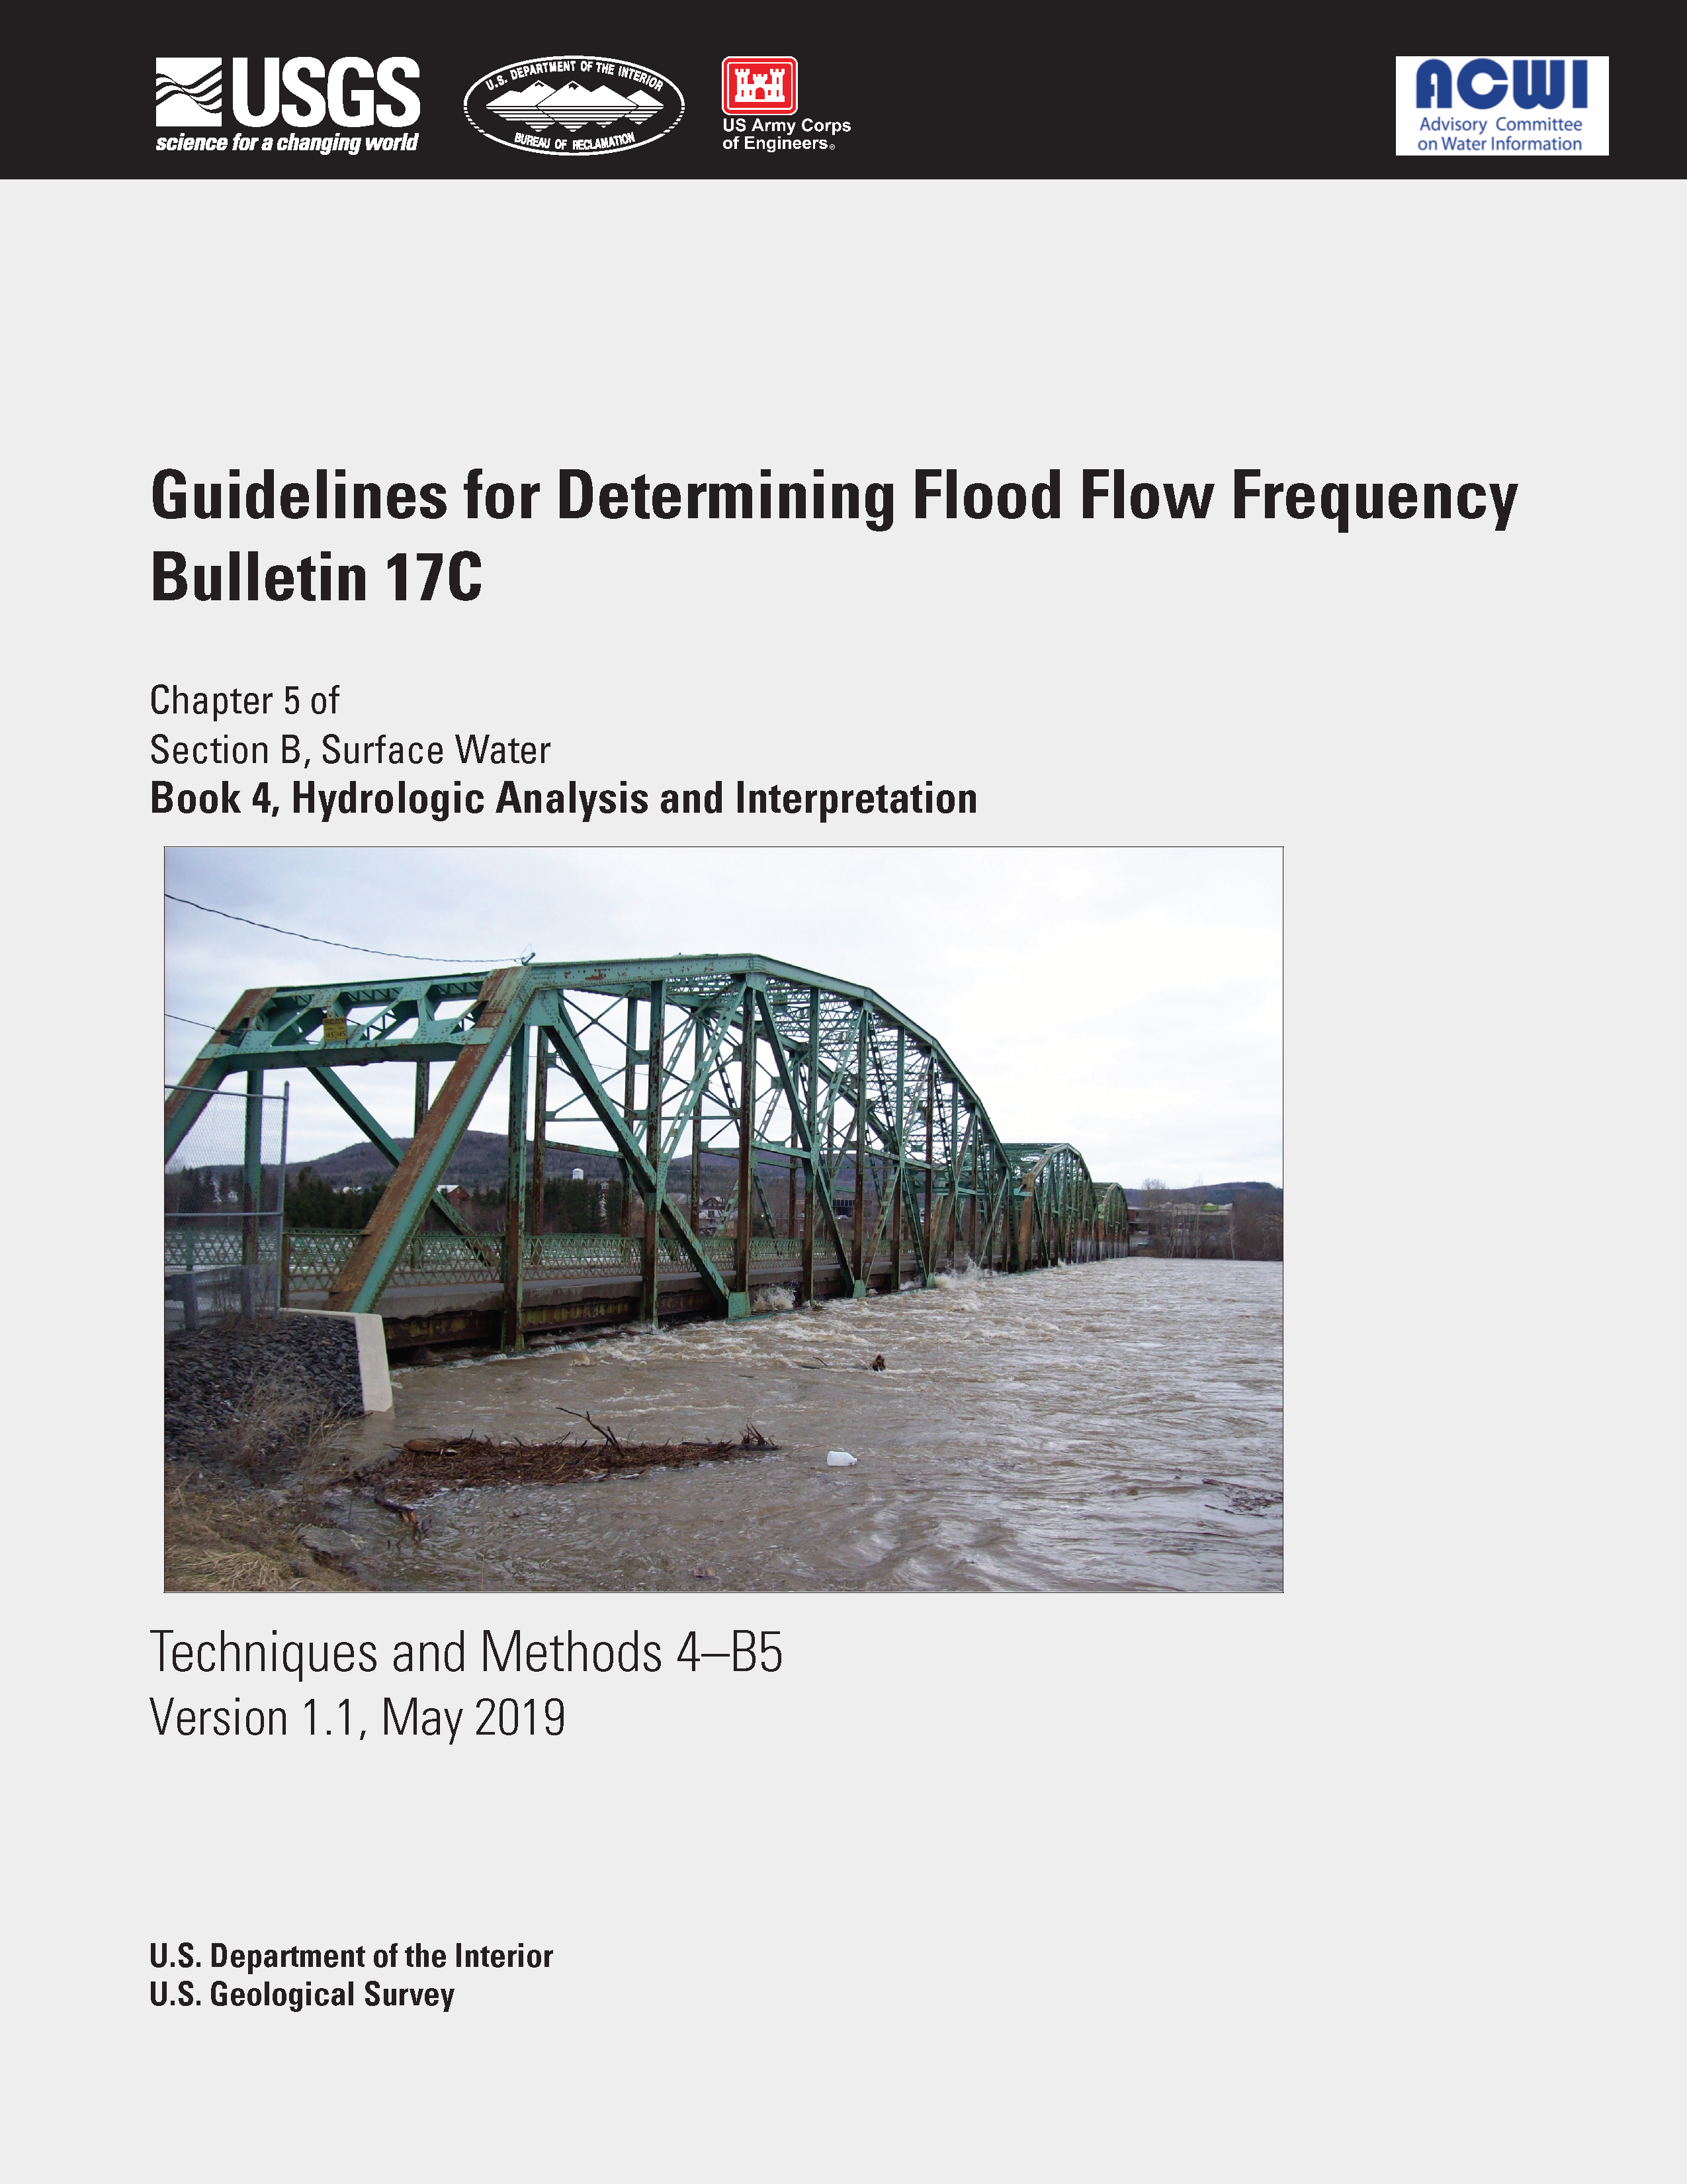
Bulletin 17C
The Work Group did not evaluate methods to account for climate variability in flood frequency. Additional work in this area is warranted.

Slide 16
These issues will make their way into Federally mandated methods.
In the past, the north-central/central US was not studied much during the development of Federal guidelines (Bulletin 17B skew for example had serious shortcomings for SD & MT and was not updated in Bulletin 17C).
This had an impact on flood-frequency analyses.
This work will make our region a player in future guidelines.

Slide 17
Federal, State, and Local Regulations, Orders, and Other Activities Affect What We Do
Executive Order 13653 Preparing the United States for the Impacts of Climate Change was issued November 1, 2013, as a response to the rising issue of climate change.
EO 13653 mandated that the Federal Government, as well stakeholders, must manage these risks with deliberate preparation, cooperation, and coordination in order to effectively improve climate preparedness and resilience
Attempted to plan for the following impacts:
High Temperatures
Heavy Downpours
Permafrost Thawing
Ocean Acidification
Sea Level Rise
Rescinded on March 28, 2017.
Could come back in some form. States or other government entities could institute such considerations.

Slide 18
Whether or not climate change is addressed explicitly, we live in an area of high natural hydroclimatic variability.
Long-term hydroclimatic processes (that may be affected by climate change) still have to be dealt with in planning. Executive (or other) orders may come and go, but that is on a shorter time scale than the design life of many projects.
A regional approach provides some consistency among States.

Slide 19
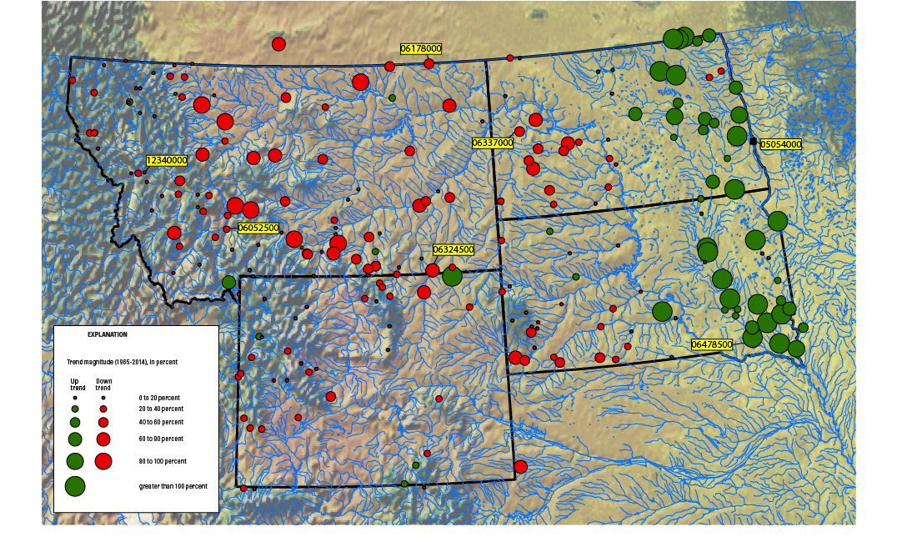
Hydroclimatic Variability
We want to better understand the hydroclimatic variability of our region and provide actionable science related to nonstationary flood-frequency analysis.
Preliminary Information-Subject to Revision. Not for Citation or Distribution.

Slide 20
Hydroclimatic Persistence
We have advanced the knowledge hydroclimatic persistence in this region. There is decadal scale (and greater) variability in our streamflow.
Flood rich/flood poor periods
We need to make this relevant to design periods.
Flood-frequency curves for warm-dry periods, wet-cool periods, warm-wet periods, …

Slide 21
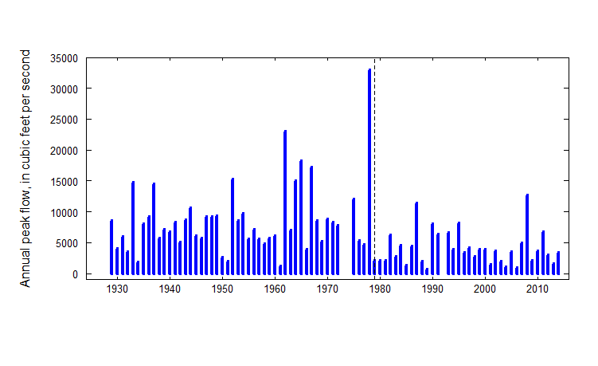
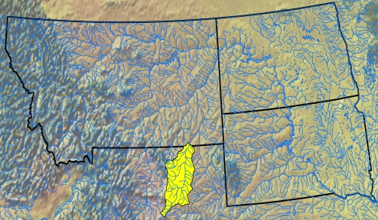
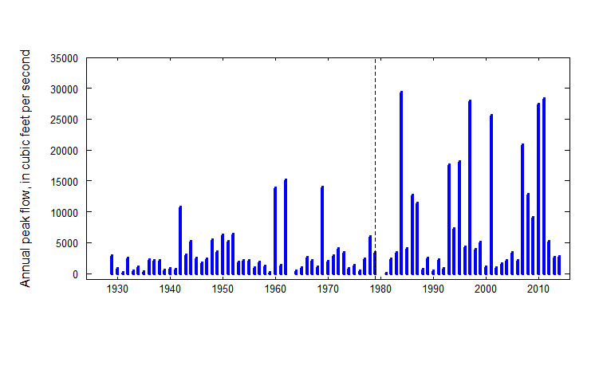
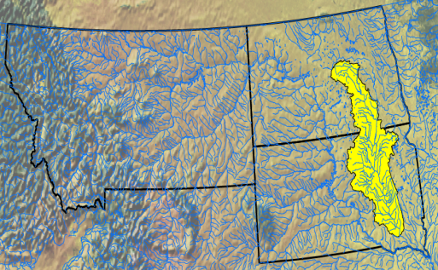
Annual Peak Flows
Powder River at Moorhead, Montana
James River at Scotland, South Dakota
Preliminary Information-Subject to Revision. Not for Citation or Distribution.
Courtesy: Steve Sando, USGS WY-MT Water Science Center

Slide 22
Peak-flow Frequency Curves
Powder River at Moorhead, Montana
James River at Scotland, South Dakota
Courtesy: Steve Sando,
USGS WY-MT Water Science Center
Preliminary Information-Subject to Revision. Not for Citation or Distribution.

Slide 23
Considering infrastructure design life
Choose representative period of record
Choose stationary or nonstationary model for representative period
Luke et al. (2017)
Decide if current conditions represent future period
Will a model calibrated on climate indicators from 1960-1989 perform well on data from 1990-2019?
Which climate indicators might perform better?
Does choice of calibration and validation periods matter?
Choose (range of) projections
Slide Courtesy Jory Hecht, USGS
Preliminary Information-Subject to Revision. Not for Citation or Distribution.

Slide 24
Scope of Work–Communication
(7) Succinctly summarize the above work in a Fact Sheet or Story Map that provides links to project products to make it easy to find data and results.
Summary
Some plain-language interpretation.
Communication to a broader audience.
Communication is not something you add on to science, it is of the essence of science.
Alan Alda

Slide 25
Additional Thoughts
We believe that better data, analyses, and interpretations make better decisions.
Could inform future regionalization. Nonstationarity in regionalization is an open question.

Slide 26
Additional Thoughts
This (and other work the USGS is doing for the FHWA) will provide defensible methods and a body of data analysis and literature to support decision making.
Hydroclimatic analysis could benefit other studies.

Slide 27
Q & A

